Slide 1
Cell Arrays - basics

Slide 2
Data Structures
Data structures: store more than one value, organize data
Vector/Matrix: all values are of the same type.
Cell array: values can be of different types.
Structs: organize data into a group, with each data entry having a field name.

Slide 3
Creating cell arrays
Same rules as creating numerical matrices, but use { instead of [
>> cellmat = { 23, 'a'; 1:2:9, 'hello' }
cellmat =
[ 23] 'a'
[1x5 double] 'hello’
To create a cell array of empty entries, use cell() function.
>> cellmat = cell(2,3)
cellmat =
2×3 cell array
{0×0 double} {0×0 double} {0×0 double}
{0×0 double} {0×0 double} {0×0 double}

Slide 4
Creating cell arrays
>> cellrowvec = { 23, 'a', 1:2:9, 'hello' }
>> cellcolvec = { 23; 'a'; 1:2:9; 'hello' }
>> cellmat = { 23, 'a'; 1:2:9, 'hello' }
>> emptycellmat = cell(2,2)
cellrowvec =
[23] 'a' [1x5 double] 'hello'
cellcolvec =
[ 23]
'a'
[1x5 double]
'hello'
cellmat =
[ 23] 'a'
[1x5 double] 'hello'
emptycellmat =
[] []
[] []

Slide 5
Indexing cell arrays
Matrix indexing: ( )
Creates a new cell vector/matrix from the indexed entries.
Content indexing: { }
Extracts the contents of the indexed entries.
Same indexing rules apply: Linear vs. Row-Column indexing, Numerical vs Logical indexing

Slide 6
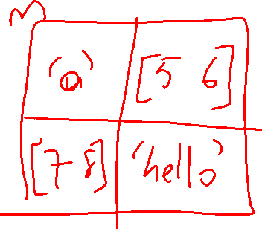
Indexing cell arrays
>> m = { 'a', 5:6; 7:8, 'hello' }
>> m{1,2}
ans =
5 6
>> m{2:3}
ans =
7 8
ans =
5 6
>> [ x y ] = m{2:3}
x =
7 8
y =
5 6
>> m{3}(2)
>> m(1:2)
ans =
1×2 cell array
{'a'} {1×2 double}
>> m(1)
ans =
1×1 cell array
{'a'}
>> [ m{2:3} ]
ans =
7 8 5 6
>> { m{2: 3} }
1x2 array
{1x2 double} {1x2 double}

Slide 7
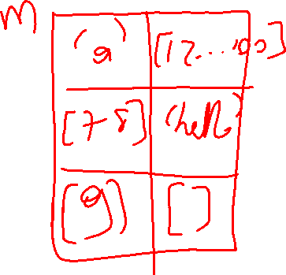
Size of Cell arrays
numel/size do not care about the "content" in cell elements.
>> m = { 'a', 1:100; 7:8, 'hello'; 9, [ ] }
>> size(m)
>> size( m(2) )
>> size( m(1, 1:2) )
>> size( m{4} )
>> numel(m)

Slide 8
varargin, nargin
varargin: a cell array of unnamed input arguments
nargin: total number of input arguments the function is called by (including both named and unnamed arguments)
function [y]=smallest( x, varargin )
y =x
for i = 1:numel(varargin)
if varargin{i} < y
y=varargin{i};
end
end
fprintf ( 'nargin=%d\n', nargin )
>> smallest( 5, 3 )
nargin=2
ans =
3
>> smallest( 5, 3, 2, 10 )
nargin=4
ans =
2

Slide 9
Optional output arguments: varargout, nargout
function [f,p]=factorandprimes( n )
f = factor( n );
p = primes( n );
function [f,p]=factorandprimes_v2( n )
f = factor( n );
if nargout>=2;
p = primes( n ); end
function [f,varargout]=factorandprimes_v3( n )
f = factor( n );
if nargout>=2;
varargout{1} = primes( n ); end
>> tic; f=factorandprimes(1000000000); toc
Elapsed time is 11.0 seconds.
>> tic; f=factorandprimes_v2(1000000000); toc
Elapsed time is 0.003 seconds.

