Slide 1
Structures

Slide 2
Structures
Group properties of objects into a data structure.
>> laptop=struct('brand','apple', 'cpu',3.3, 'year',2012, 'price',1499)
laptop =
brand: 'apple'
year: 2012
cpu: 3.3000
price: 2000
brand: | apple
cpu: | 3.3
year: | 2012
price: | 1499

Slide 3
Dot operator
>> laptop.brand
apple
>> laptop.brand = 'sony'
laptop =
brand: 'sony'
cpu: 3.3000
year: 2012
price: 1499
>> brand = 'price';
>> laptop.(brand)
>> laptop.(brand) = 1999
>> laptop.country
??? Reference to non-existent field 'country’.
>> %the following is okay, it will add a new field to structure.
>> laptop.country = 'US'

Slide 4
functions for structures
>> fieldnames( laptop )
ans =
'brand'
'cpu'
'year'
'price'
>> isstruct(laptop)
1 (logical)
>> isfield( laptop, 'brand' )
1 (logical)
>> isfield( laptop, 'user' )
0 (logical)
>> getfield( laptop , 'brand' )
>> brand ='price'; getfield(laptop, brand)
>> setfield( laptop, 'brand', 'lenovo')
>> rmfield( laptop, 'cpu')
>> laptop = rmfield(laptop, 'cpu')

Slide 5
Vectors of structures
>> points = struct( 'x', 0, 'y', 0);
>> %points(1) = struct( 'x', 0, 'y', 0);
>> points(2) = struct( 'x', 1, 'y', 0);
>> points(3) = struct( 'x', 6, 'y', 5);
>> points(2).y = 4;
>> points(2) = [ ];
When structures are extended, uninitialized entries are empty vector.
>> points(10) = struct( 'x', 7, 'y', 9);
>> points = struct( 'x', {0 1 7}, 'y',{0 5 9})

Slide 6
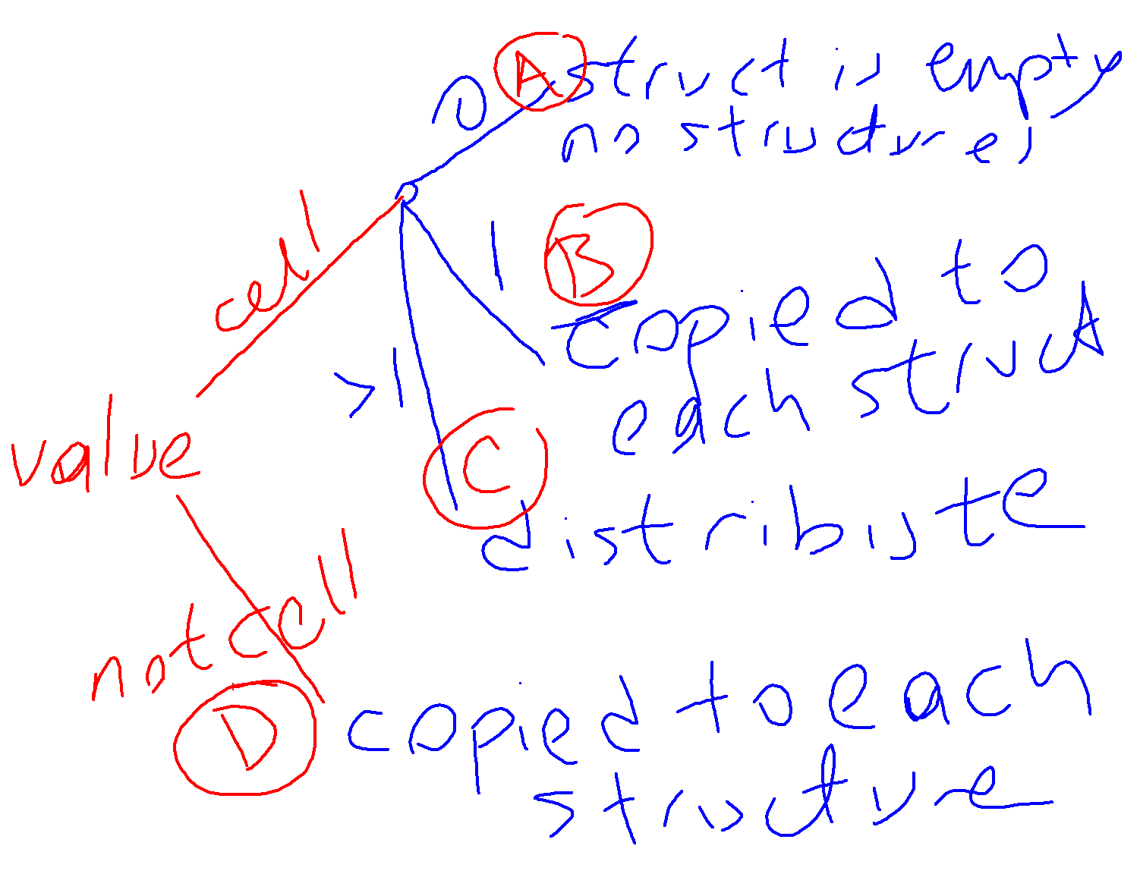
struct(‘…’, value1, ‘…’, value2, … )

Slide 7
Creating Multiple Structures
points = struct( 'x', {1, 3, 5} , 'y' , {10, 20, 30} );
points = struct( 'x', {1, 3, 5} , 'y' , {10, 20, 30}, 'z', 5 );
points = struct( 'x', {1, 3, 5} , 'y' , {10, 20, 30}, 'z', {5} );
points = struct( 'x', {1, 3, 5} , 'y' , {{10,20,30}} );
points = struct( 'x', [1, 3, 5] , 'y' , [10 20 30]);
points = struct( 'x', [1, 3, 5] , 'y' , {10 20 30});
points = struct( 'x', {} , 'y' , {} );

Slide 8
Fields of structure arrays
>> points = struct( 'x', 0, 'y', 3, 'v',[4 5], 'name','apple');
>> points(2) = struct( 'x', [], 'y', 6, 'v', [], 'name','orange');
>> points(3) = struct( 'x', 1, 'y', 9, 'v',[10 12 15], 'name','banana');
>> points(1).x
>> a = points.x
>> [ points.x ]
>> { points.x }
>> [points.name]
>> {points.name}
>> [ points([3 2 3]). y ]
[4 5 ]
[10 12 15 ]

Slide 9
Exercise
Add up all the y axis of the points.
s = 0;
for i=1:numel(points)
s = s + points(i).y;
end
Alternative:
s = sum ( [ points.y ] )
[4 5 ]
[10 12 15 ]

Slide 10
Exercise
Add up the values of y axis only if it is odd.
s = 0;
for i=1:numel(points)
a = points(i).y;
if mod(a,2) == 1
s = s + a;
end
end
Alternative:
wise = [ points.y ];
I = mod(wise,2) == 1;
s = sum ( wise(I) );
[4 5 ]
[10 12 15 ]
Alternative:
wise = [ points.y ];
I = mod(wise,2) == 1;
s = sum ( [ points(I).y ] );

Slide 11
Structures can contain any data type.
>> laptops(1).price = [1499 1599 1999];
>> laptops(1).cpu = struct('brand','intel', 'speed', 3.3);
It is good practice to store the same data type in each field of a structure vector.
E.g., the following is allowed, but not recommended:
>> laptops(1).brand = {'apple', 'macbookpro'}
>> laptops(2).brand = 'sony’;
The following is better:
>> laptops(2).brand = {'sony', ''} ;

Slide 12
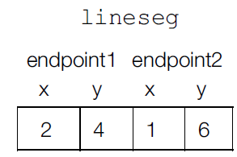
Nested structures
>> lineseg = struct( ...
'endpoint1', struct('x',2,'y',4) ...
, 'endpoint2',struct('x',1,'y',6) ...
)
>> point1 = struct('x',2,'y',4) ;
>> point2 = struct('x',1,'y',6) ;
>> lineseg = struct( ...
'endpoint1', point1, 'endpoint2', point2 );
>> lineseg.endpoint1.x =3
>> lineseg.endpoint1
ans =
x: 3
y: 4
>> point1.x = 5
>> lineseg.endpoint1

